Slide 1
Few-shot image generation for defect detection
Avadhut Sardeshmukh

Slide 2
Problem Statement
Asset inspection at scale is challenging — requires automation.
Anomalies are rare → limited training data for each defect type.
Goal: Generate synthetic defect images to augment training data.
Solution: Fine-tune a pre-trained diffusion model for class-conditional image generation.

Slide 3
Model and Fine-tuning Approach
Chosen model: DiT-XL/2
Diffusion Transformer, class-conditional, trained on ImageNet.
Most DefectSpectrum images are texture-like, transformer is known to work well on such images because of its larger receptive field.
Data: The products hazelnut and screw
Similar class labels are available in ImageNet; easier to tune class embeddings
Fine-tuning strategy
Adapted from DiffFit[4] - biases + LayerNorm weights (parameter-efficient)
Full fine-tuning runs the risk of catastrophic forgetting, is GPU memory intensive
Used HuggingFace diffusers for implementation
Class embeddings are part of LayerNorm in Huggingface implementation of DiT

Slide 4
Data Preprocessing and Augmentation
Image resolution: 128x128
Preprocessing
Center crop 800x800 (to reduce the unnecessary background)
Normalization to [-1,1] range
Augmentations: RandomFlips and sometimes Rotation
Also tried jittering brightness, contrast, etc., and histogram equalization – but these didn’t help as expected
How to extend/optimize for multi-GPU training?
Use DistributedDataParallel – replicate model on each GPU, with their own batch, gradients synchronized after backward()
Use a DistributedSampler inside the dataloader class to ensure each GPU gets a different slice of the data, while covering the entire data overall

Slide 5
Hyperparameters
Batch size – Experimented with 1, 2, 4 and 8
Typically small batch size worked better, and I used 2 in most experiments
Learning rate scaled according to batch size
Learning rate – Tried 1e-6, 1e-5, 2e-5, 5e-5 (depending upon batch size)
LR 1e-5 with batch size 2 worked better than others
Gradient accumulation – To account for small batch sizes, used gradient accumulation for 2 steps before updating weights
Noise scheduler steps
Tried 20, 40, 100, 200,500 and 1000. Generally, 100-200 worked better
Mixed precision training – to enhance GPU memory efficiency

Slide 6
Evaluation Metrics
To evaluate the quality of generated images
Fretchet Inception Distance – captures quality and diversity of samples; measures the Frechet’s distance between real and generated distributions
FID to be computed at class level - the difference between class-conditional distributions
Variations such as KID (which capture higher-order statistics)
Perceptual quality metrics such as MS-SSIM[10] and LPIPS[9] (class-level)
To evaluate the utility of generated images
Add generated images to the real data. Train classifiers on both, real and augmented data
Hypothesis – Metrics should significantly improve with the augmented data. Metrics – Precision, recall, F1, and others
If additional annotations (e.g. segmentation mask) are available, they can be used to get more detailed metrics such as mAP@k
Alternatively, get embeddings of generated images -> KNN classification (no training) in embedding space – Evaluates the class-alignment in generated images

Slide 7
Further Enhancements
Other parameter-efficient fine-tuning methods
LoRA methods. For e.g., DriveDitFit[3] suggested a LoRA method for tuning attention weights in DiT
DriveDitFit also suggested to initialize class embeddings with the nearest class embeddings from ImageNet, based on CLIP similarity (rather than the superficial label level similarity as we used)
Dreambooth & Textual Inversion [5,6]
Embed new concepts in the models space by introducing rare tokens. e.g., sks_scratch for a scratch defect
Leveraging additional information/annotations
ControlNet: Conditional generation with segmentation masks
Classifier-free guidance tuning (not exposed in HuggingFace DiT)
Knowledge distillation into smaller models

Slide 8
How to leverage segmentation masks?
Pass the segmentation maks as extra conditioning information to a suitable architecture such as ControlNet
Pass the conditioning image through a parallel convolution network, and inject the features into the main network with residual connections
Add class-conditioning mechanism to ControlNet
Can pass the class-embedding to Unet blocks (e.g. add to the timestep embedding)
Alternatively, can append the class embedding as an extra channel in the segmentation mask (with suitable projection+reshaping)
Represent the class label as a text prompt (e.g., “a screw with crack”) and use text-conditional ControlNet – combine guidance from both
Classifier-free guidance could be used to guide the sampling process (also need conditioning drop-out during training)

Slide 9
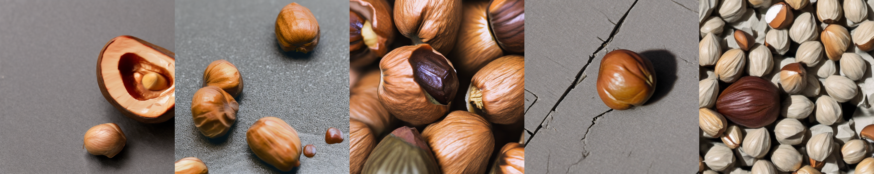
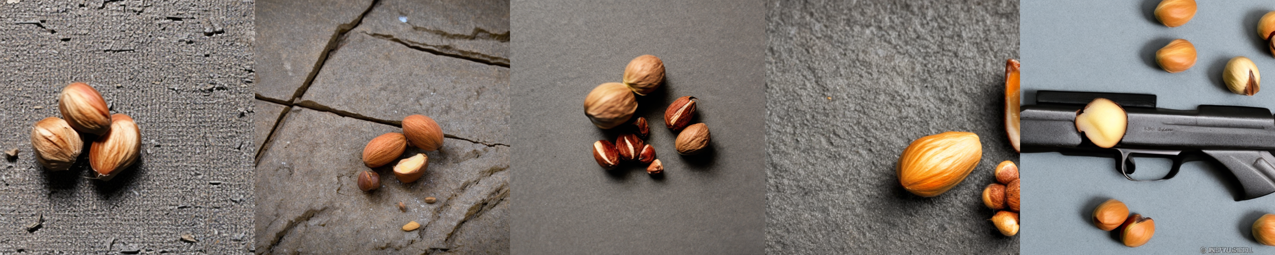
Textual Inversion
Adapted the huggingface implementation
Batch size 4, LR 4e-5, train steps 200, sampling steps 30, guidance scale 7.5
Challenges
There are two concepts in our problem – the product (e.g. hazelnut) and the defect (crack)
Textual inversion learns the general concept of defect (crack) well
Sometimes the association of crack and hazelnut is not as expected. E.g., the last image in the left grid – the crack is on the surface, not the nut
With more specific defects (e.g., for a screw, scratch_head, scratch_thread), this could be more challenging
Also, ‘sks’ is a rifle, so it has been suggested not to use it as a prefix (right grid)

Slide 10
References
[1] Menglin Jia et al. Visual prompt tuning. ECCV, 2022. [2] Edward J Hu et al. LoRA: Low-rank adaptation of large language models. ICLR, 2022. [3] Jiahang Tu et al. DriveDitFit: Fine-tuning diffusion transformers for autonomous driving data generation. ACM TOMM, 2025. [4] Enze Xie et al. DiffFit: Unlocking transferability of large diffusion models via simple parameter-efficient fine-tuning. ICCV, 2023. [5] Nataniel Ruiz et al. Dreambooth: Fine-tuning text-to-image diffusion models for subject-driven generation, 2022. [6] Rinon Gal et al. An image is worth one word: Personalizing text-to-image generation using textual inversion, 2022. [7] Lvmin Zhang et al. Adding conditional control to text-to-image diffusion models.
[8] Elad Ben Zaken et al. BitFit: Simple parameter-efficient fine-tuning for transformer-based masked language models. ACL 2022.
[9] R. Zhang, P. Isola, A. A. Efros, E. Shechtman and O. Wang, "The Unreasonable Effectiveness of Deep Features as a Perceptual Metric," in 2018 IEEE/CVF Conference on Computer Vision and Pattern Recognition (CVPR
[10]Wang, Z. & Simoncelli, Eero & Bovik, Alan. (2003). Multiscale structural similarity for image quality assessment. Conference Record of the Asilomar Conference on Signals, Systems and Computers. 2. 1398 - 1402 Vol.2. 10.1109/ACSSC.2003.1292216.

